Slide 1
ANSI SQL
SQL Clauses

Slide 2

Session Objectives
At the end of the session you will be able to
Identify the clauses in ANSI SQL .
Define Group by clause
Define Having clause
Define Order By clause

Slide 3
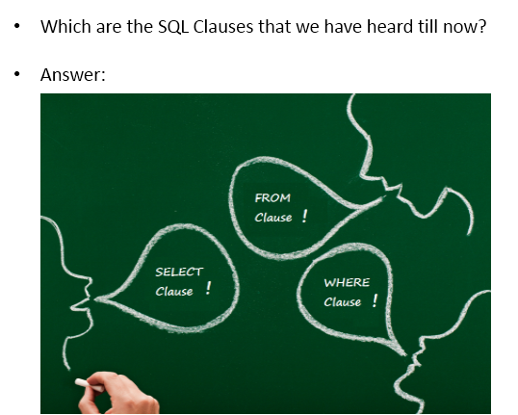
Do You Know?

Slide 4
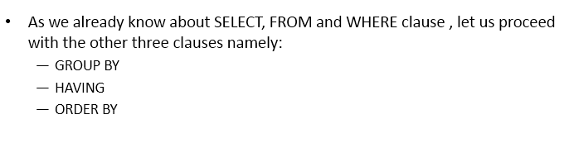
Introduction

Slide 5
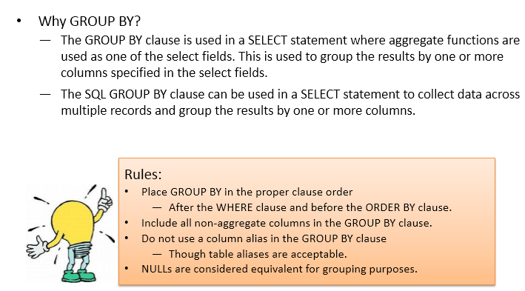
Why Group By clause?

Slide 6
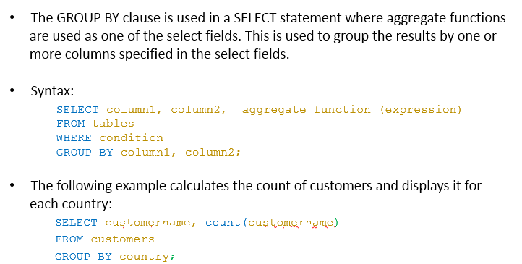
What is a Group By clause?

Slide 7
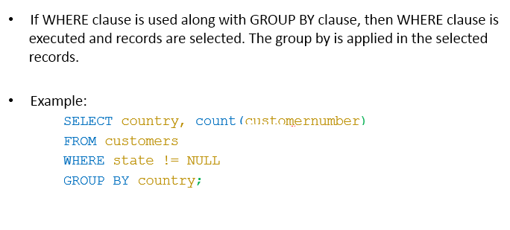
Group by clause with where clause

Slide 8
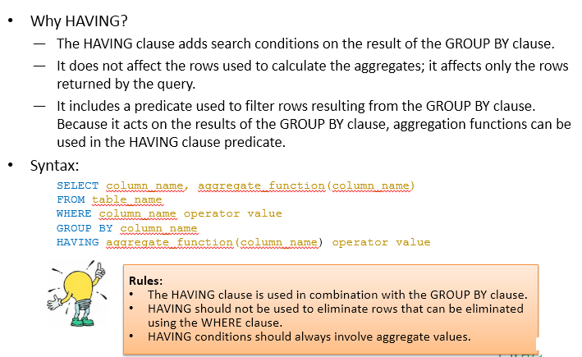
Why Having clause?

Slide 9
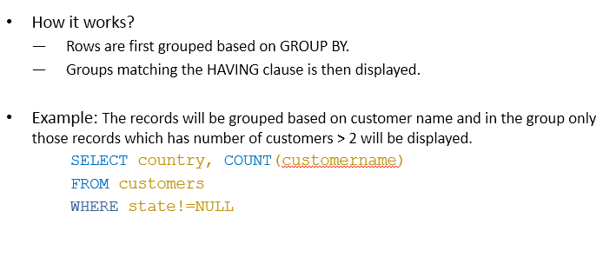
Using a Having clause with Group By

Slide 10
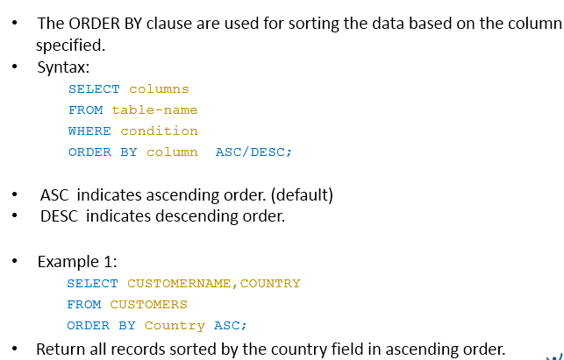
What is a Order By Clause?

Slide 11
You have completed SQL Clauses

